Slide 1
Fidget Tools in the Classroom
Susan Purcell-Orleck
SEL Facilitator
Meigs Academic Magnet Middle School

Slide 2

how do we fidget?
Tap our pencil
Shake our foot
Twirl our hair
Play with a paperclip
Doodle on our notes

Slide 3
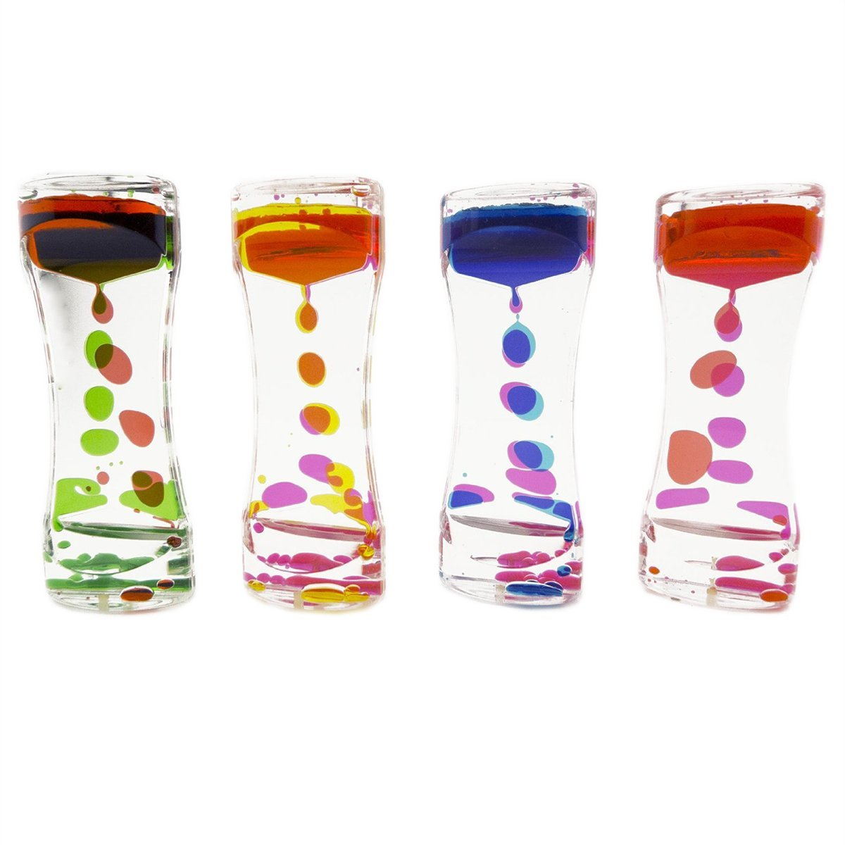
WHY do we fidget?
Subtle movement
Touch input
Helps calm our bodies
Keeps our minds attentive, alert, and focused

Slide 4
Research shows that MOVEMENT is …
A POWERFUL COMPONENT OF FOCUS AND PROBLEM SOLVING

Slide 5

the 7 sensory systems
Hearing
Touch
Sight
Taste
Smell
Vestibular
Proprioceptive

Slide 6

the VESTIBULAR system …
Maintain balance
Experience gravitational security
Centered in the inner ear
When we move our heads, the fluid in these organs moves and shifts to provide information about the position of our heads and bodies.

Slide 7

the proprioceptive system …
When we move, our muscles stretch and contract
Proprioception refers to the ways joints and muscles send message to the brain to help coordinate movement
Allows us to grade the force and direction of our movements

Slide 8

WHAT DO YOU NEED TO DO?
Find a tool that helps you focus and problem solve.
Avoid the tools that distract you from your task.
Be considerate of others … students & teachers.

Slide 9
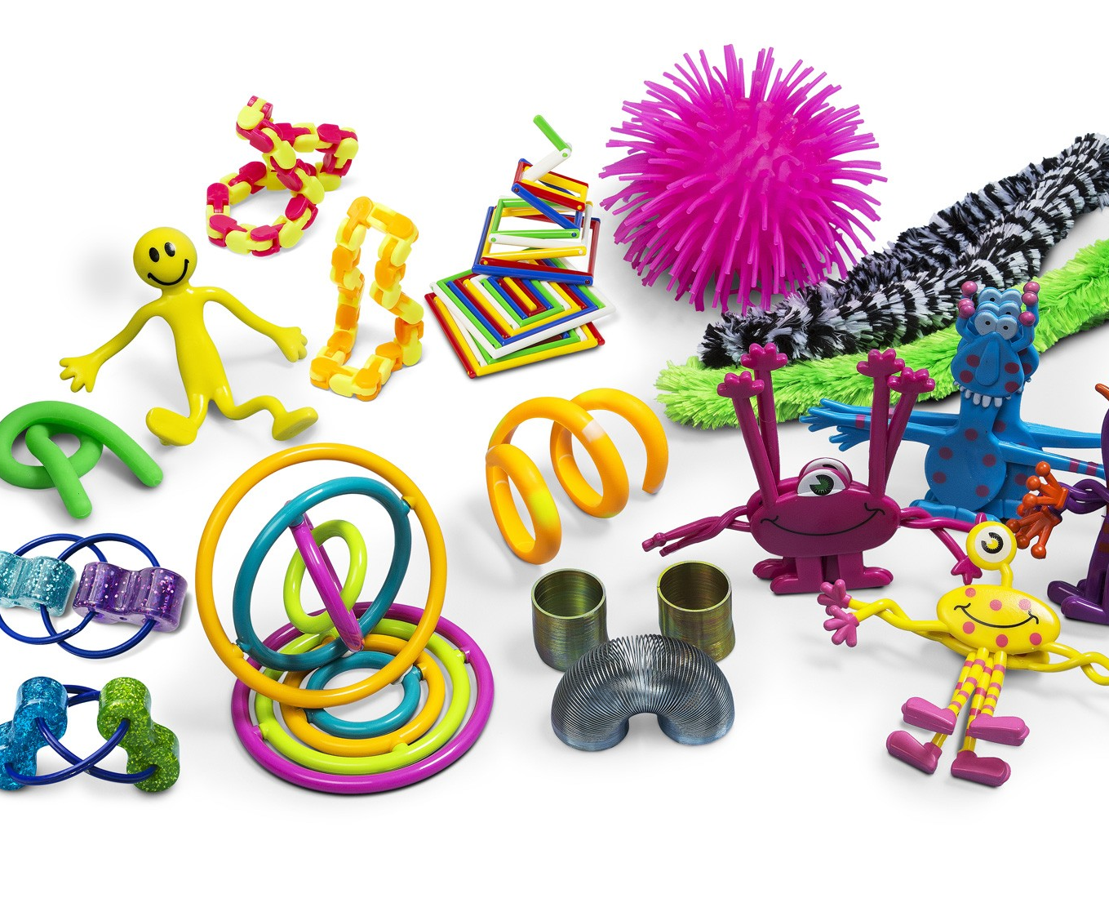
Possible stress tools
Fidget Tools
Music or White Noise
A Quiet Space
Pillows or Cushions
Glitter Jars
Weighted Blanket
Rocking Chair
Stuffed Animals

Slide 10
Your Responsibility
Take care of the tools!
Follow the check-out procedures of your classroom teacher.
The tools are either in your hand or on the desk.
Nothing touches the tools except your hand.
Choose a tool that will help you pay attention and calm your body … not distract yourself or others.

