Slide 1
Transitioning into Middle School
Christina Lane,
Northern Middle Tennessee Representative, Student Outreach Services

Slide 2
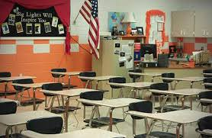
Movin’ On Up
New school, new location, or maybe just maybe the same school
New people
New school subjects
New teachers
It’s a chance for adventure and to start with a clean slate.
Congrats!!

Slide 3
Making Friends
Positive people make you a better person
Helps in making good choices
Going to the right places
Doing the right things
Be a leader, not a follower
Make yourself a better person by surrounding yourself with good friends!!!

Slide 4
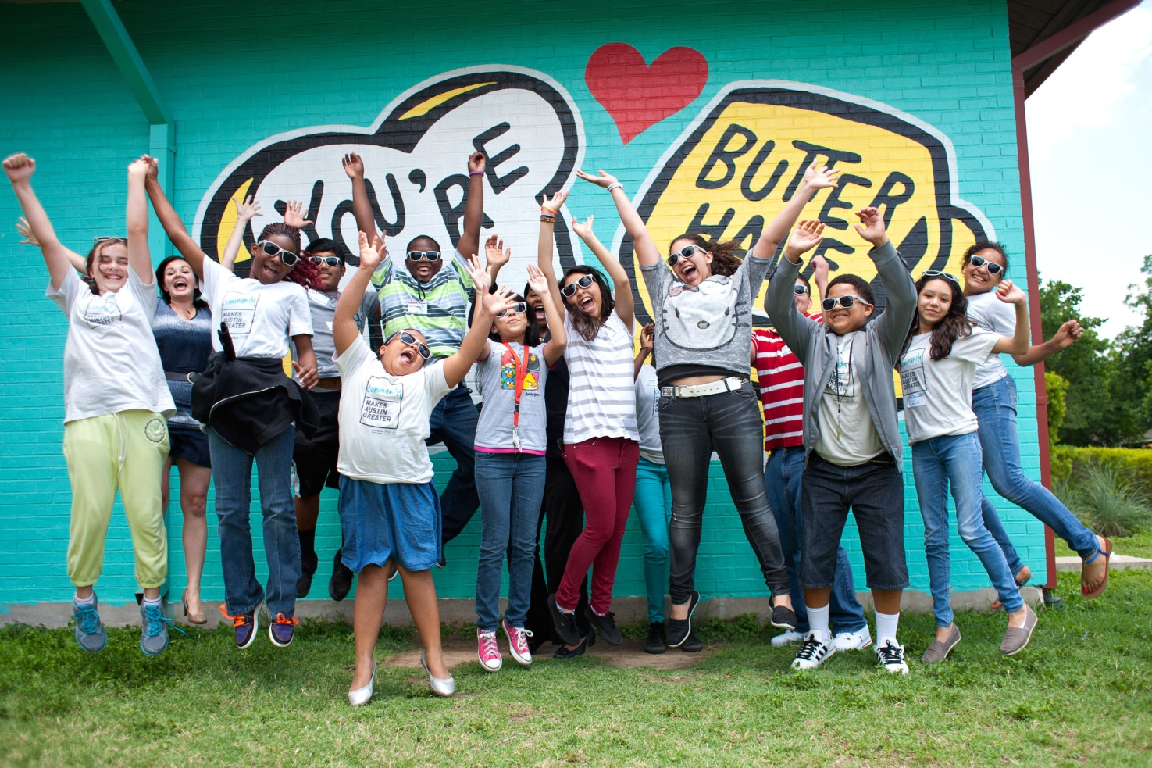
You’ll be a PRO in no time
Have the right attitude
Get solid information on what to expect
Middle school teachers help students build on the fundamentals they learned in ______ school and prepare them for the more difficult curriculum they will face in ____ school.

Slide 5
What’s Different?

Slide 6
More Work!
More Challenging
Papers and Exams in addition to Homework
More responsibility
Different grading scale

Slide 7
Lockers
You have your own space now – keep it organized!
Decorate it – make it your home space (follow the school guidelines)
If no lockers, then keep your backpack organized.

Slide 8
Library
Much bigger
More to offer – computers, video stations, other forms of media
Great place to do homework, study for tests, and gather research.
Ask the librarian for book recommendations.

Slide 9
Class Schedule
Keep a copy of schedule in your notebook
Ask for help if needed
Different classes on different days
Different room every hour

Slide 10
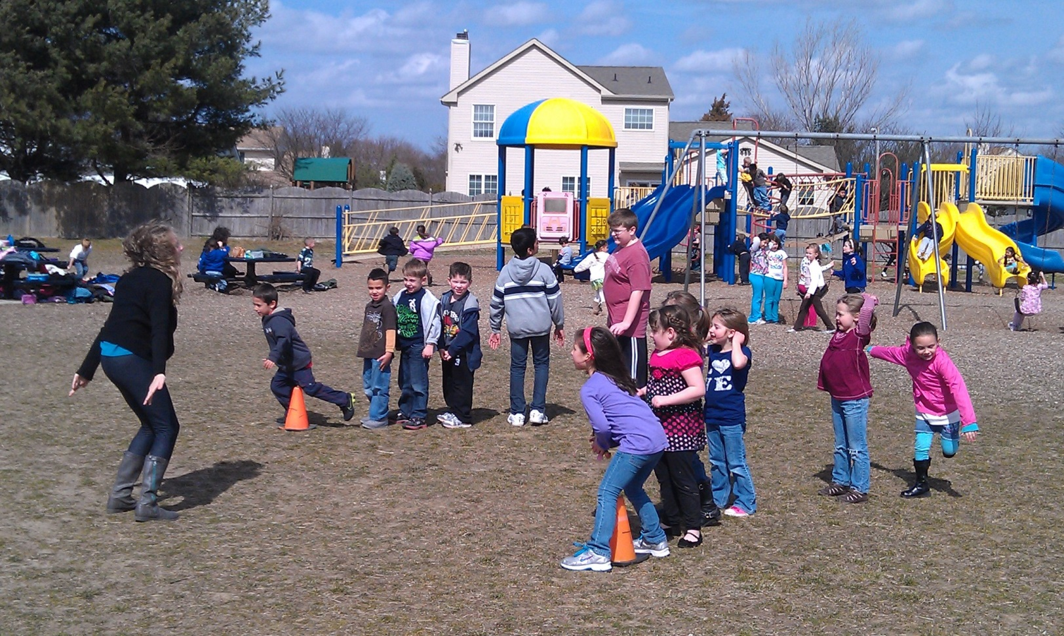
Bye-Bye Recess
You will survive without it!

Slide 11
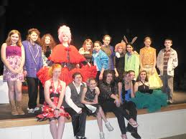
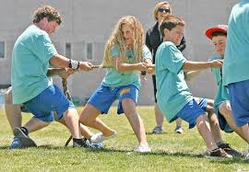
Get Involved!
Sports
Clubs
Activities
Explore new interests
Make new friends
Have lots of fun!

Slide 12
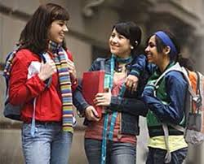
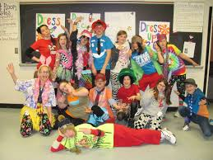
The Student Body
Moving from the oldest kid to the youngest
These kids were young once – they will help you.
If you ever feel bullied, just tell a teacher or counselor.
Try to keep yourself open to all kinds of friends.

Slide 13
How to keep peace with friends?
Always tell the truth
Never spread rumors
Only say things that build people up
Trust others
Always apologize

Slide 14
Rumor – I heard that anyone who fails the next history test is going to have to repeat the course over the summer.
Not verified
The person telling it does not know if it is true.
Spread fast
Spread from person to person
Spread to a whole group of people
Change
Rumors can change slightly each time they’re told.
They can get more exaggerated over time

Slide 15
Gossip – Jane told me that when she tried to ask Craig out to a movie, he got so nervous that he almost fainted.
Gossip deals with subjects that are shocking or personal.
Gossip is usually about private things that people do not usually talk openly about.
Gossip is usually spread behind the person’s back.
Gossip can be true, false, or a rumor.

Slide 16
Social Media
Before you speak, text, or tweet,
T
I
K
H
N
true
inspi
r
ing
kind
?
Is it
helpful
necessary

Slide 17
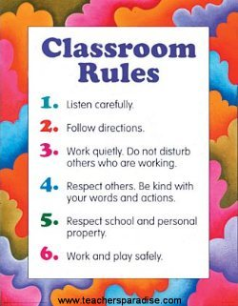
New Rules
Attendance
Dress Code
Disciplinary procedures
Other administrative policies

Slide 18
People you Need to Know
Principal
Assistant Principal (s)
School Counselor
School Nurse
SRO – School Resource Officer
Get to know all your teachers – they are here to help you!

Slide 19
Where can you find us?
www.planningyourdreams.org
www. ecampustours.com
www.edsouth.org/SOS
Like us on Facebook

